Slide 1

Housing Prices Prediction and Seasonality Analysis
Group 15 – TIØ4317
Group members: Mathea Aune Bardal, Mathias Berthet, Matthias Ludvic Ransau, Miha Jan

Slide 2
Presentation Agenda
Introduction and project goal
Data
Preprocessing the data
Stationarity
The need for stationarity
Transformation of our data set
Testing for stationarity
Determining Model Parameters
ACF – Determining q
PACF – Determining p
AIC and BIC testing
Prediction and Evaluation
Evaluation Metrics
ARIMA Model Evaluation
SARIMA Model Evaluation
Conclusion

Slide 3


Introduction
Project Goal: Find most suitable model for data set and predict future values
Importance of accurate housing prices within various sectors (real estate investment, urban planning, policy making etc.)
Many factors affecting housing market
Exploring ARIMA (AutoRegressive Integrated Moving Average)
SARIMA (Seasonal ARIMA) to remove seasonal effects

Slide 4
Presentation Agenda
Introduction and project goal
Data
Preprocessing the data
Stationarity
The need for stationarity
Transformation of our data set
Testing for stationarity
Determining Model Parameters
ACF – Determining q
PACF – Determining p
AIC and BIC testing
Prediction and Evaluation
Evaluation Metrics
ARIMA Model Evaluation
SARIMA Model Evaluation
Conclusion

Slide 5
Data
About the data
Preprocessing
Data for various regions in Singapore
Information per house
Price per square meter (USD), area
Monthly timestamp
Data from 1990 to 2021
Preprocessing ensures clean, structured data for ARIMA modeling
Filtered transactions to Bedok and set a proper datetime index
Resampled data to monthly averages for consistency

Slide 6
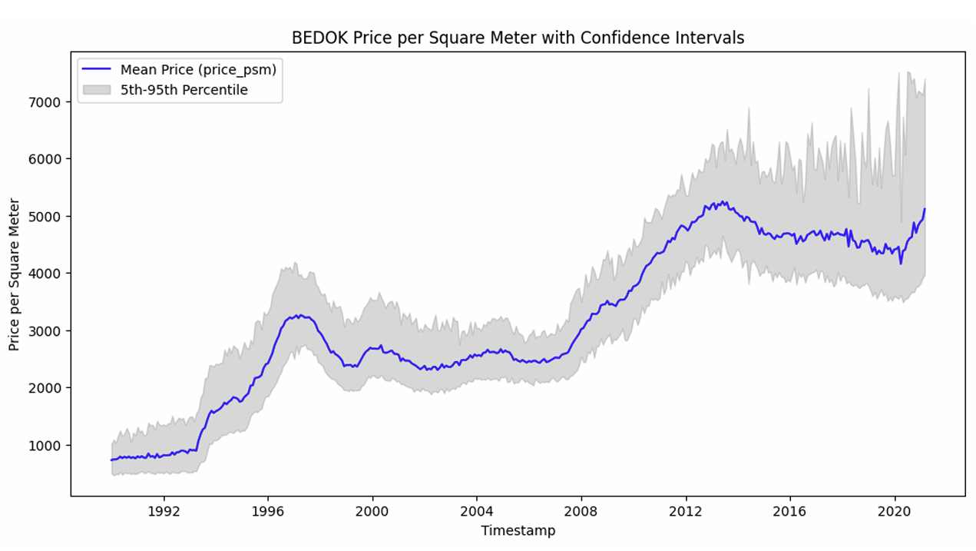
Plot of the dataset of monthly Bedok price per square meter
Plotted mean prices (blue line) with 5th–95th percentile range for insights (shaded area)
Steady price growth observed, with higher volatility in recent years.

Slide 7
Presentation Agenda
Introduction and project goal
Data
Preprocessing the data
Stationarity
The need for stationarity
Transformation of our data set
Testing for stationarity
Determining Model Parameters
ACF – Determining q
PACF – Determining p
AIC and BIC testing
Prediction and Evaluation
Evaluation Metrics
ARIMA Model Evaluation
SARIMA Model Evaluation
Conclusion

Slide 8
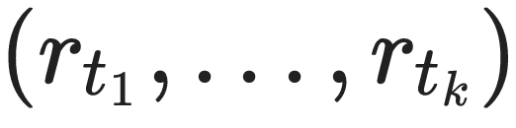
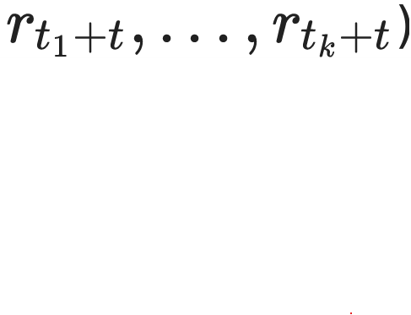
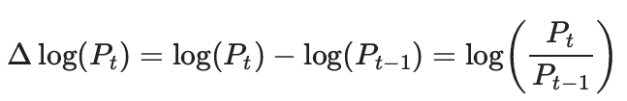
About Stationarity
The Need for Stationary Data
Transformation of data set
Series behave consistently and predictably
When joint distribution of
Is identical to: (
Stationarity is critical for ARIMA; Model performance, predictions and estimates can become unreliable and misleading
Data was not stationary after preprocessing (looking at plot of the data), hence used log transformation as explained mathematically:
Assumed then stationarity, but still had to perform stationarity tests
Testing for stationarity

Slide 9
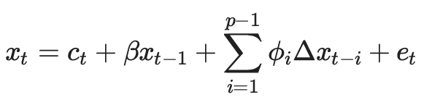
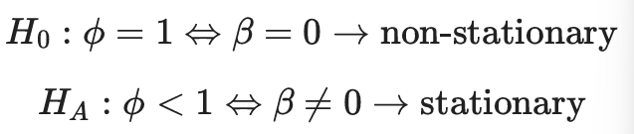
Testing for stationarity - ADF
Testing Process
Test Results
Used Augmented Dickey-Fuller test (ADF-test)
Checks for unit roots -> indication of nonstationarity
Test statistic:
With test hypothesizes:
ADF test statistic: -3.7514
P-Value: 0.0034
We reject the null hypothesis, stating that the data is stationary

Slide 10
Presentation Agenda
Introduction and project goal
Data
Preprocessing the data
Stationarity
The need for stationarity
Transformation of our data set
Testing for stationarity
Determining Model Parameters
ACF – Determining q
PACF – Determining p
AIC and BIC testing
Prediction and Evaluation
Evaluation Metrics
ARIMA Model Evaluation
SARIMA Model Evaluation
Conclusion

Slide 11
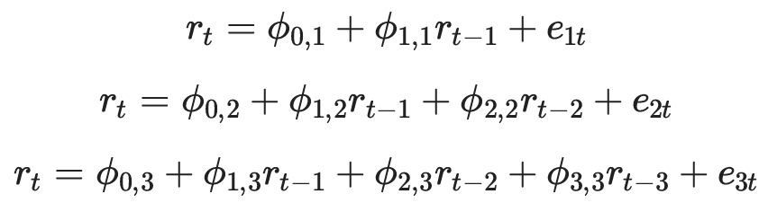
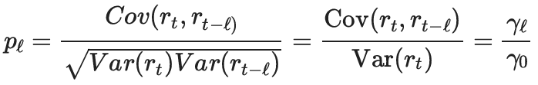
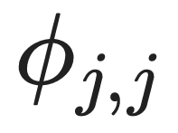
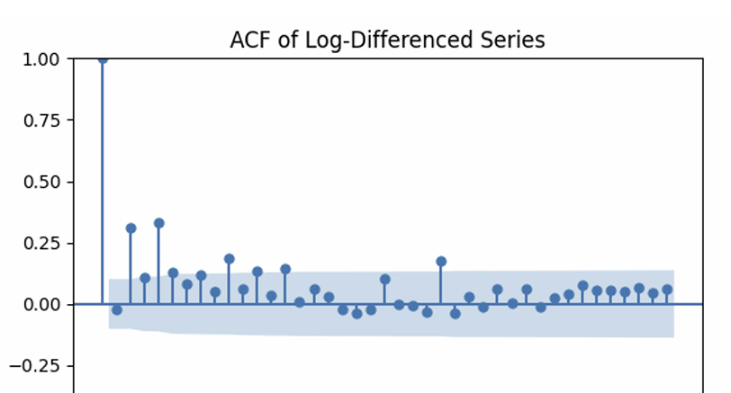
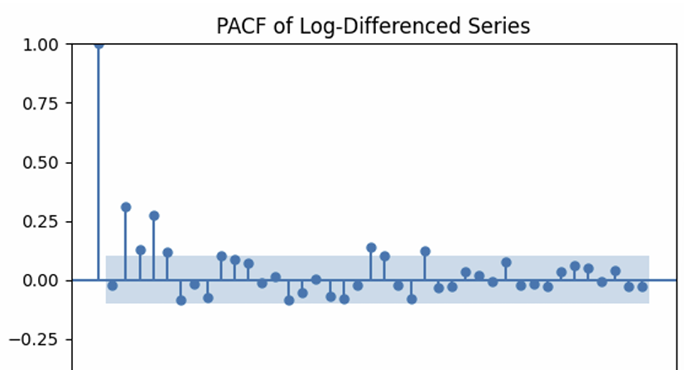
ACF and PACF testing
ACF – determining q
PACF – determining p
q: The MA-term, helps determine the number of lags in the model
ACF: Autocorrelation function
Plotting the correlation between r_t and r_t-l. The value of q is implied by where the plot “cuts off”
Here implying:
q = 1 or 4
Giving information about how much past lag helps predict present value, considering AR models of different orders:
is the PACF at lag j, showing how much lag j helps predict: where plot drops, is where the value is not useful anymore for prediction:
p= between 1 and 5

Slide 12
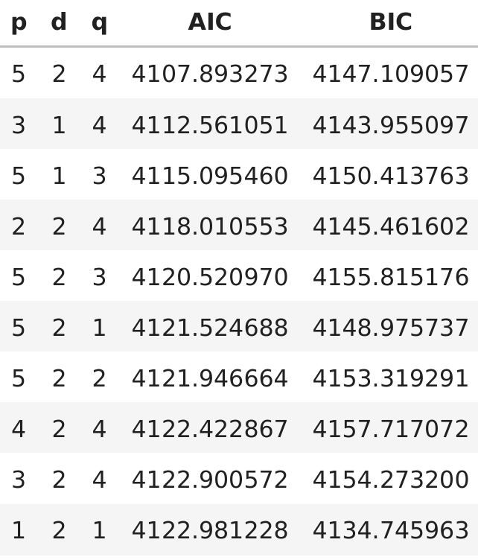
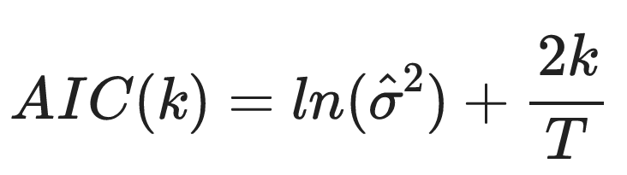
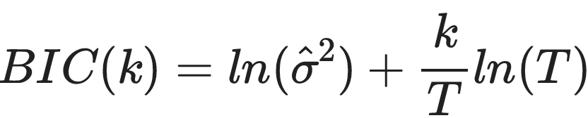
AIC and BIC testing
Akaike information criterion (AIC) and Schwarz-Bayesian information criterion (BIC)
Using a loop to check for different parameters
Selection rule: Choose the model with set of parameters with smallest value for AIC and BIC
Result: P=1, d=2 and q=1 for BIC (simpler models), if we choose based on AIC we chose p=5, d=2 and q=4 (more complex model)
Decided to use more complex model in upcoming analysis

Slide 13
Presentation Agenda
Introduction and project goal
Data
Preprocessing the data
Stationarity
The need for stationarity
Transformation of our data set
Testing for stationarity
Determining Model Parameters
ACF – Determining q
PACF – Determining p
AIC and BIC testing
Prediction and Evaluation
Evaluation Metrics
ARIMA Model Evaluation
SARIMA Model Evaluation
Conclusion

Slide 14
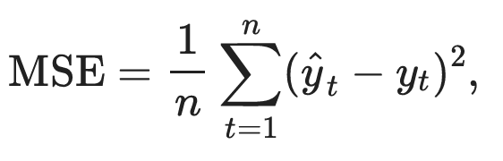
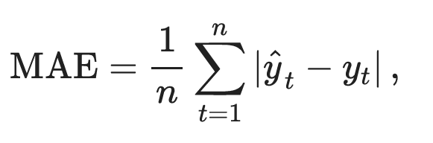
Evaluation Metrics
Mean Squared Error (MSE)
Mean Absolute Error (MAE)
Data was split into 90/10 training/test
Using both MSE and MAE allows us to capture a more comprehensive picture of model accuracy – balancing the sensitivity to large errors (MSE) with the interpretability of average error magnitude (MAE)
Will further compare data to different plots

Slide 15
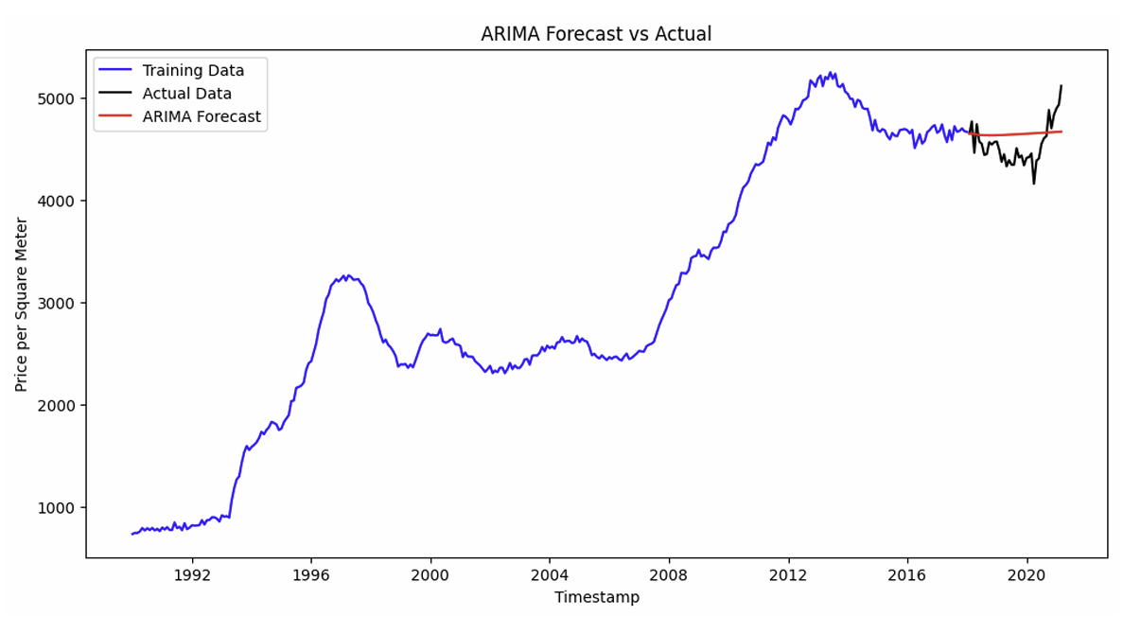
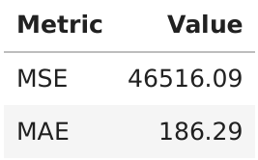
ARIMA Model Evaluation
Applied on log-transformed and second-differenced series: (p,d,q)=(5,2,4)
Prediction does not capture volatility, seems constant, but else, reasonably close to actual values

Slide 16
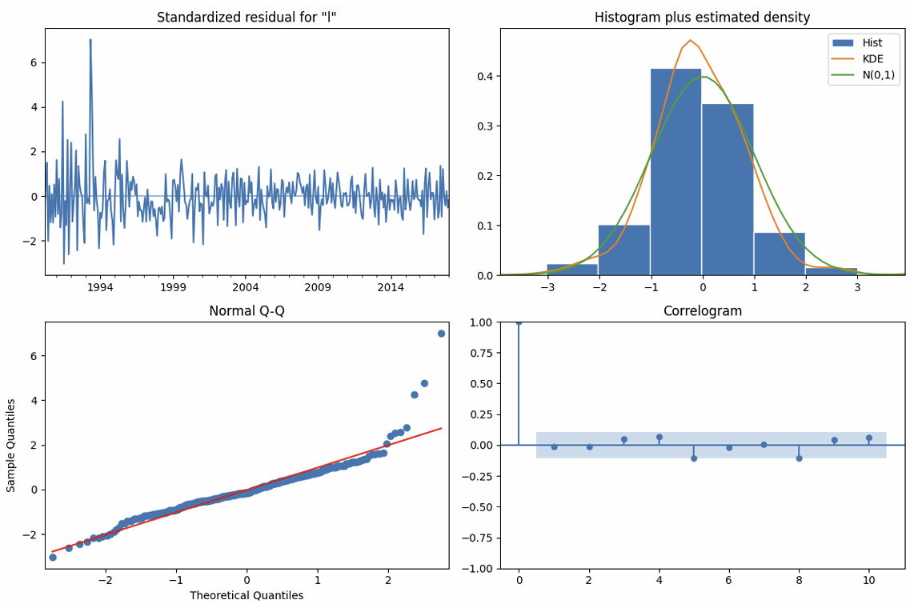

Slide 17
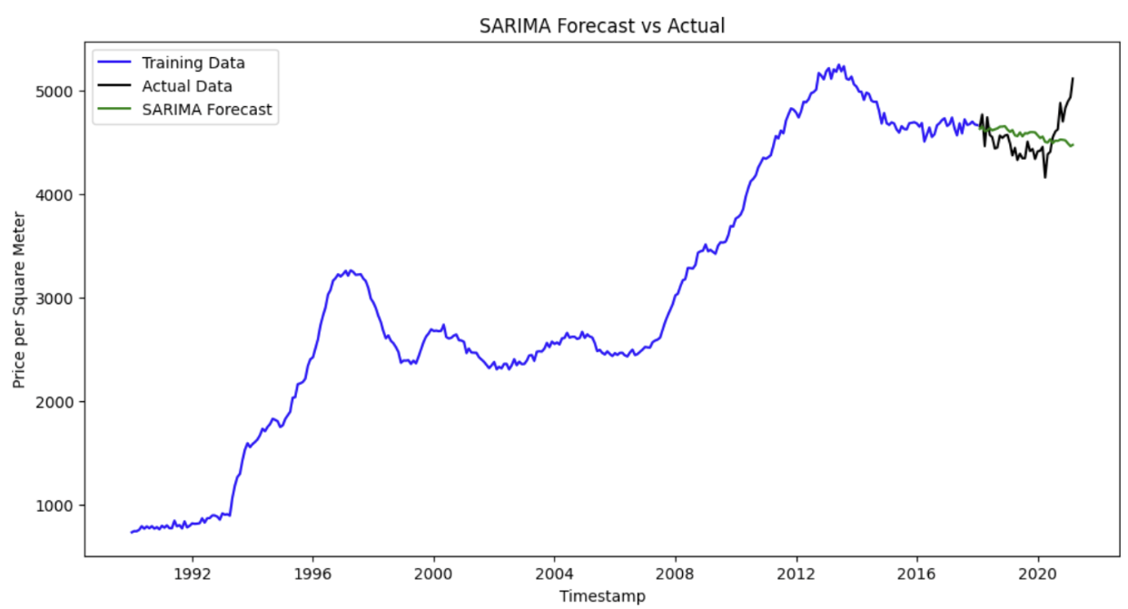
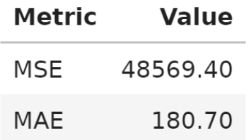
SARIMA Model Evaluation
Incorporated seasonal parameters: (5,2,4,12)
Prediction fails to recognize change in trend and turn upwards
Trying to predict for years ahead, which is complicated for such models

Slide 18
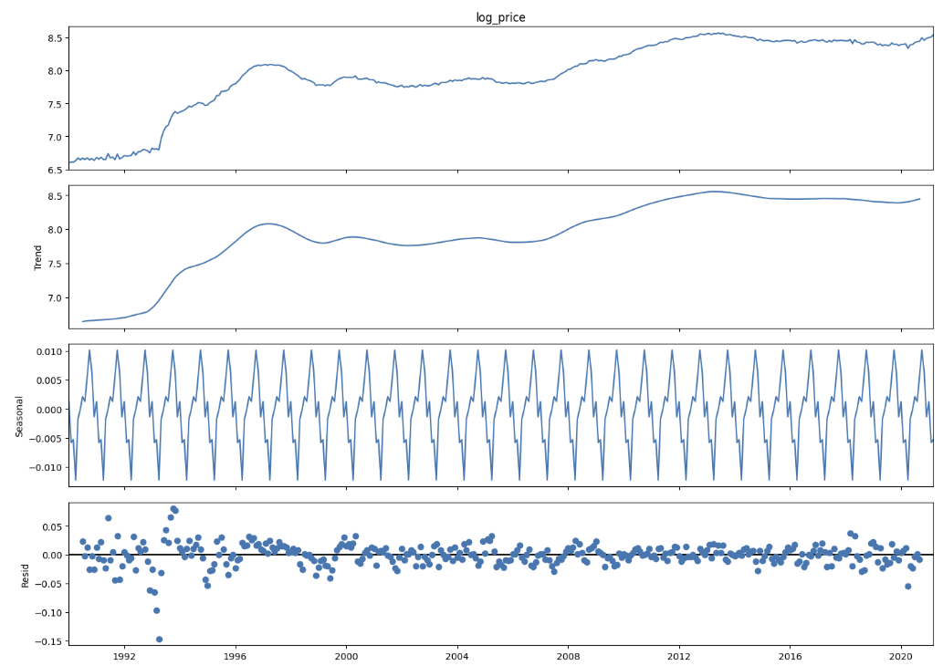

Slide 19
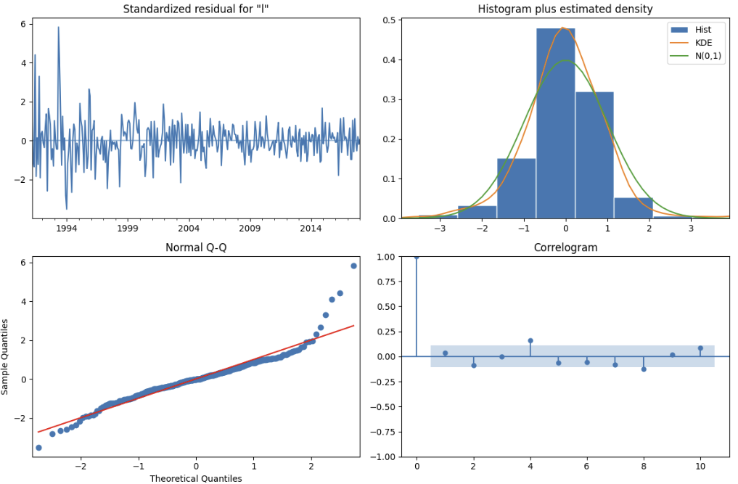

Slide 20
Presentation Agenda
Introduction and project goal
Data
Preprocessing the data
Stationarity
The need for stationarity
Transformation of our data set
Testing for stationarity
Determining Model Parameters
ACF – Determining q
PACF – Determining p
AIC and BIC testing
Prediction and Evaluation
Evaluation Metrics
ARIMA Model Evaluation
SARIMA Model Evaluation
Conclusion

Slide 21
Conclusion
ARIMA vs SARIMA:
ARIMA had lower MSE, SARIMA had lower MAE
Both performed well overall
SARIMA Strength:
Clear seasonal patterns identified
Real-World Use:
Adaptable to other cities
Useful for planners, investors, and policymakers
Code Advantage:
Minimal preprocessing needed
Works on various datasets
Conclusion:
Strong tools for housing market forecasting

